Slide 2
Welcome and Introductions
Opening Prayer
Indigenous Acknowledgement
Notes:
Introductions: Ed Kucy – Principal and Academy Administrator and I am also joined here tonight with Dan Waschuk who will be our Lead On-Ice Skill Instructor, MAson Hawkes and Tess Cossey who are our on Ice Teachers for the Hockey program
Please take a moment to mindful for our opening prayer and Indigenous Acknowledgement

Slide 3
Our School
Nature Pre-Kindergarten, Nature Kindergarten and Regular Kindergarten to Grade 8 classes
Population - 238 students - Safe/Caring - Family Feeling
Options: Digital Tech., Rec. and Leadership, Fine Arts
Boys and Girls Club - before/after school care
Hockey, Jiu Jitsu and Baseball Sports Academies
Elk Island Catholic Schools
Elk Island Athletic Association (EICS/EIPS)

Slide 4
Our Shared Vision – Sports Academy
Sports Academy program(s) is to empower and inspire students to reach their full potential, as students, athletes and individuals, and to create a supportive inclusive community that honours and celebrates student individual achievements, progress, and "whole-child" growth.

Slide 5
Our Programs
Our programs will be designed to not only help young players grow and develop their skills but also to cultivate strong, well-rounded individuals.

Slide 6
Hockey Program
With a focus on skill progression, we bring in a lead on-ice skills instructor, lead teachers, and skilled coaches working with junior, CIS, and professional hockey teams to lead on-ice instruction. Off the ice, our students will participate in age-appropriate strength and conditioning, recreational outings, and lessons on leadership and faith, all aimed at creating a well-rounded development experience.

Slide 8
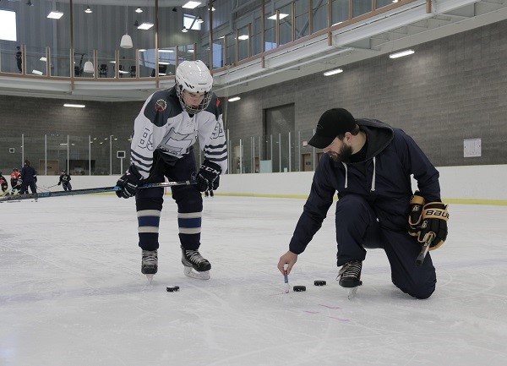
Dan Waschuk
Dan had four successful seasons in the WHL as well as captained the Grant MacEwan Men’s University hockey team. He participated in a Memorial Cup, played on the ACAC all star team and has won awards as the top scorer and Molson Cup Three Star award during his time with the Regina Pats and Saskatoon Blades. In his second season coaching with University of Alberta Golden Bears, Dan won a National CIS Championship as an assistant coach. Twelve years ago his focus shifted from playing to coaching and he has run a number of successful in season and off season hockey camps across Alberta as the founder and lead skills coach of Competitive Thread.

Slide 9
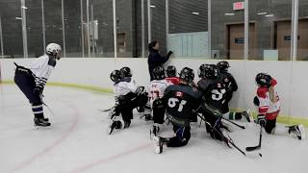
Coach Dan and Competitive Thread

Slide 10
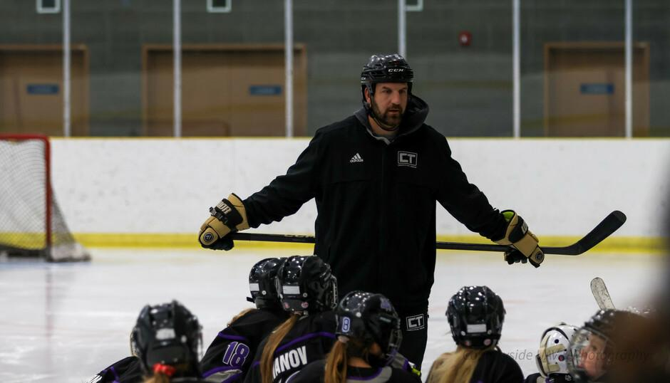

Slide 11
Facilities
Ardrossan Recreation Complex
- 10 minute walk for us to and from

Slide 12
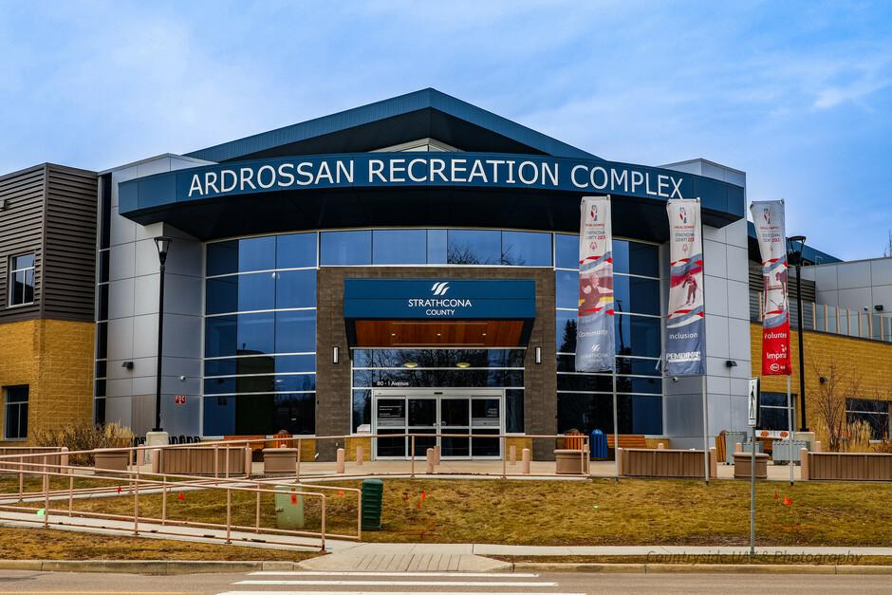

Slide 13
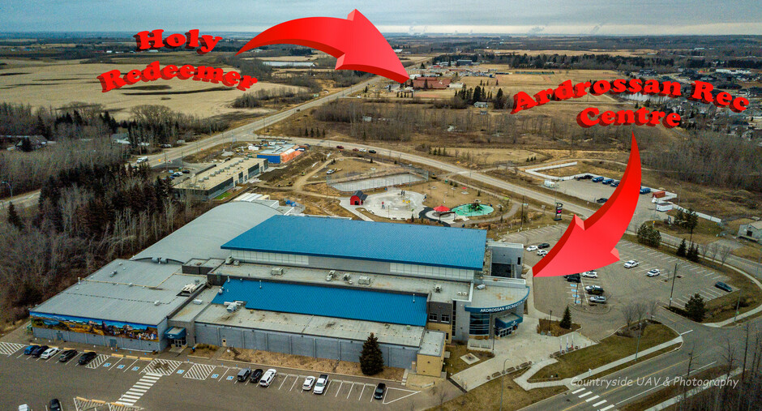

Slide 14
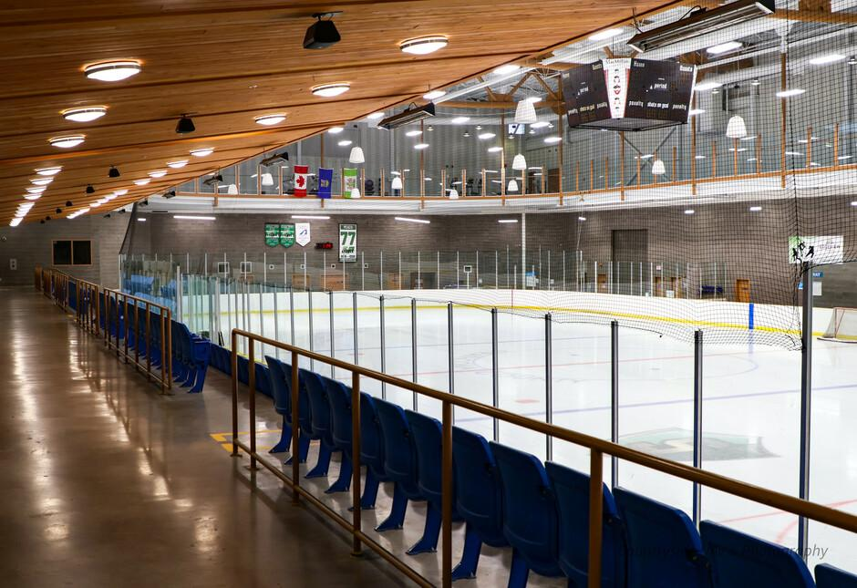

Slide 15
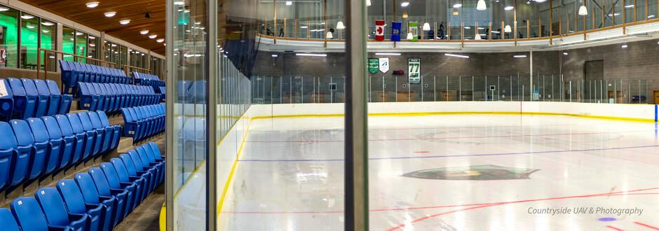
Parents are always welcome to visit and watch!

Slide 16
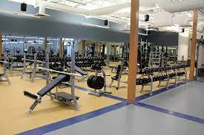

Slide 17
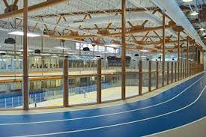

Slide 18
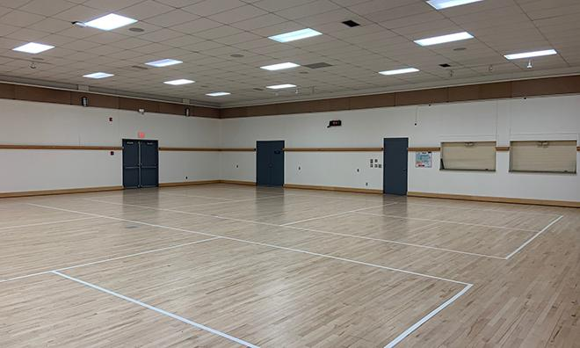

Slide 19
Training and Development
Academy - Tuesday, Thursday and Friday afternoons (May change based on enrollments)
On Ice – 2 times per week (Tuesdays and Thursdays) - From 2 to 4 groups
Fridays - Strength and Conditioning, Recreational outings (1 per month) or planned guest speakers/activities.

Slide 20
Recreational Outings
Some of the recreational items this year include: - Downhill skiing, Cross Country skiings, Snowshoeing, Swimming, Curling, Ball hockey, Lacrosse, Yoga, Spin Bikes, Rock Climbing, Golf, Tennis, Corn Maze, Pickleball, Oil Kings Game, traditional PE sports and more…

Slide 21
Athlete Assessments/Testing
2 times per year (On and Off Ice)
September/October (Pre-Training)
& May/June (Post-Training)
Testing - Video

Slide 22
Premier Strength - Hockey Specific Strength and Conditioning Training

Slide 23
Schedule
Academy student athletes will take all core classes in the morning (academy days) and full day on non-academy days.
Academy will replace students CTS choices, Physical Education and Wellness class time.
Schedule to be confirmed based on student enrollment.

Slide 24
Fees and Swag
$250/month (with a $250 enrollment deposit used in lieu of June payment)
All Academy athletes will receive:
T-Shirt, Shorts, Hoodie, Jersey
(Second year hockey academy athletes will be given an option to purchase-w/adjusted payment)

Slide 25
Admission and Requirements
Non-Catholic/Non-Boundary phone interview with Principal (Religion class requirement -School of Choice – Transportation)
Behaviour contract for all Academy students
Priority (HR students, EICS students, External)

Slide 26
Equipment Bags
AM – Bag drop off at Holy Redeemer - Academy Heated Trailer
– Bags not allowed on the EICS AM busses
PM – Bags will be transported back to the school by truck/trailer.
Students can take their bags on the bus home (Strathcona County, Sherwood Park, Fort Saskatchewan)

Slide 27
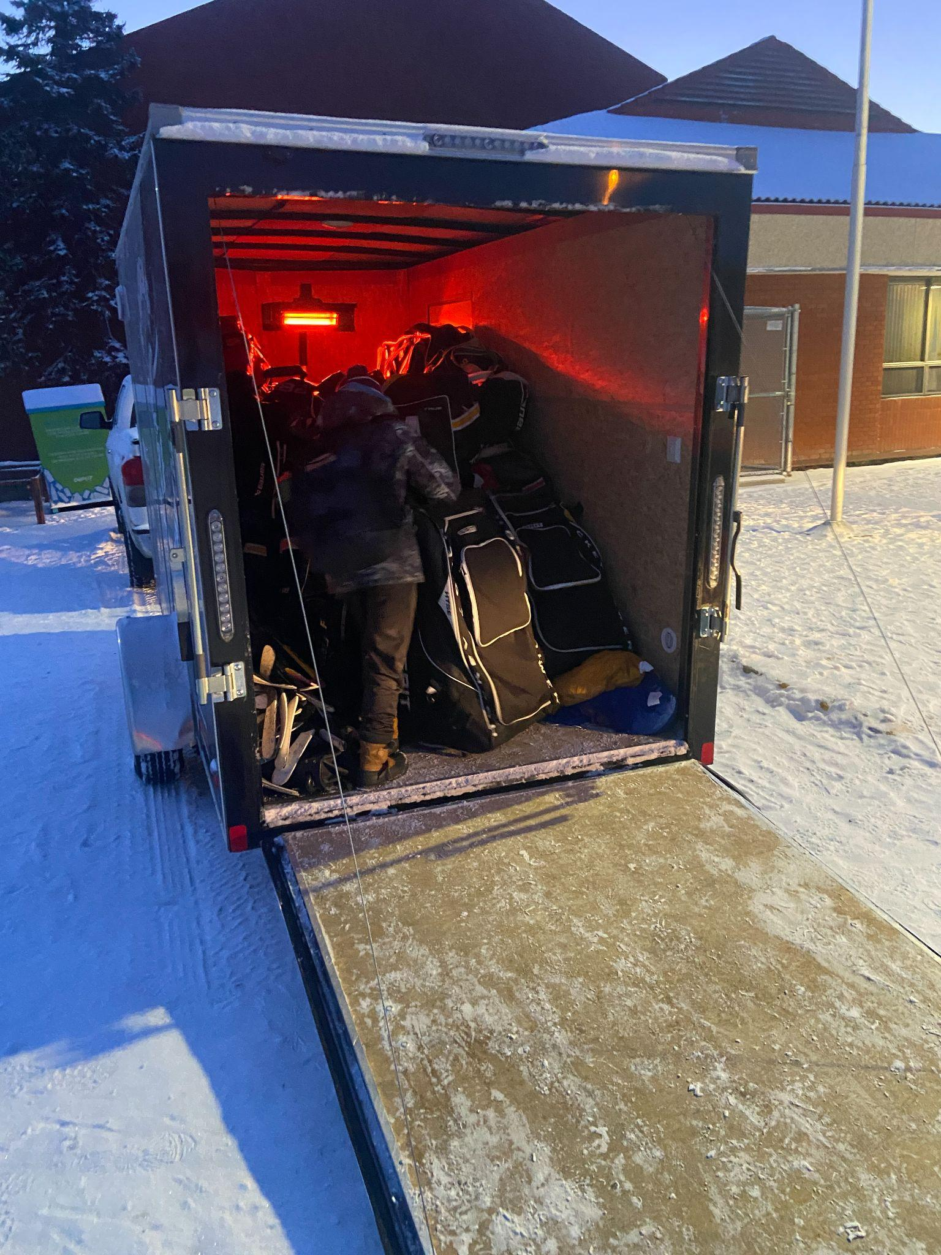
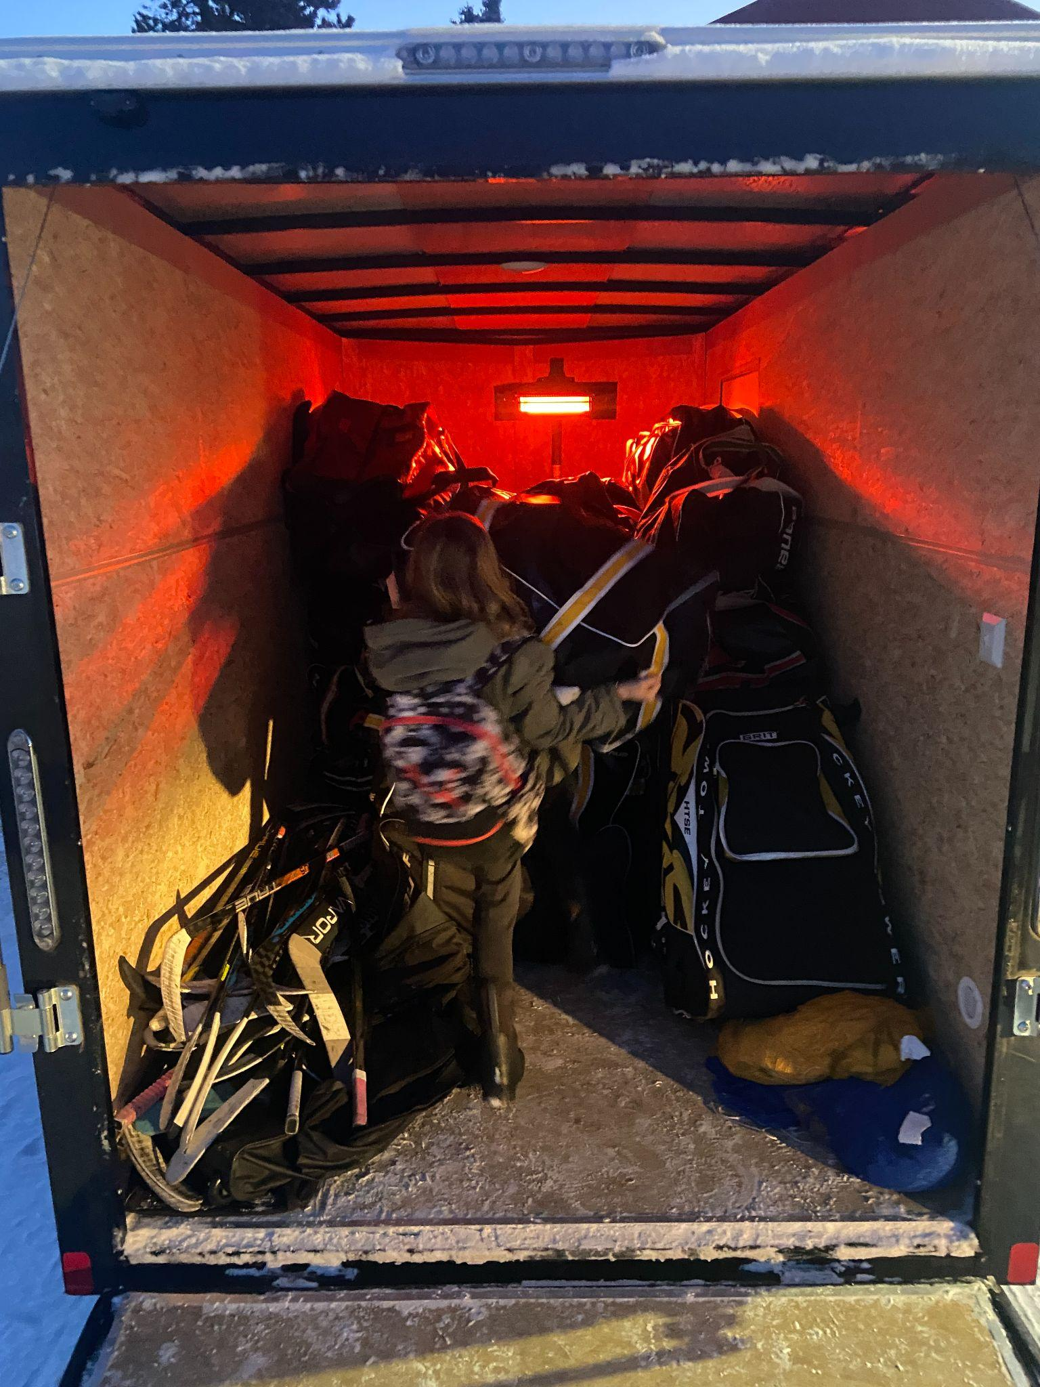
Trailer Loading - Heated

Slide 28
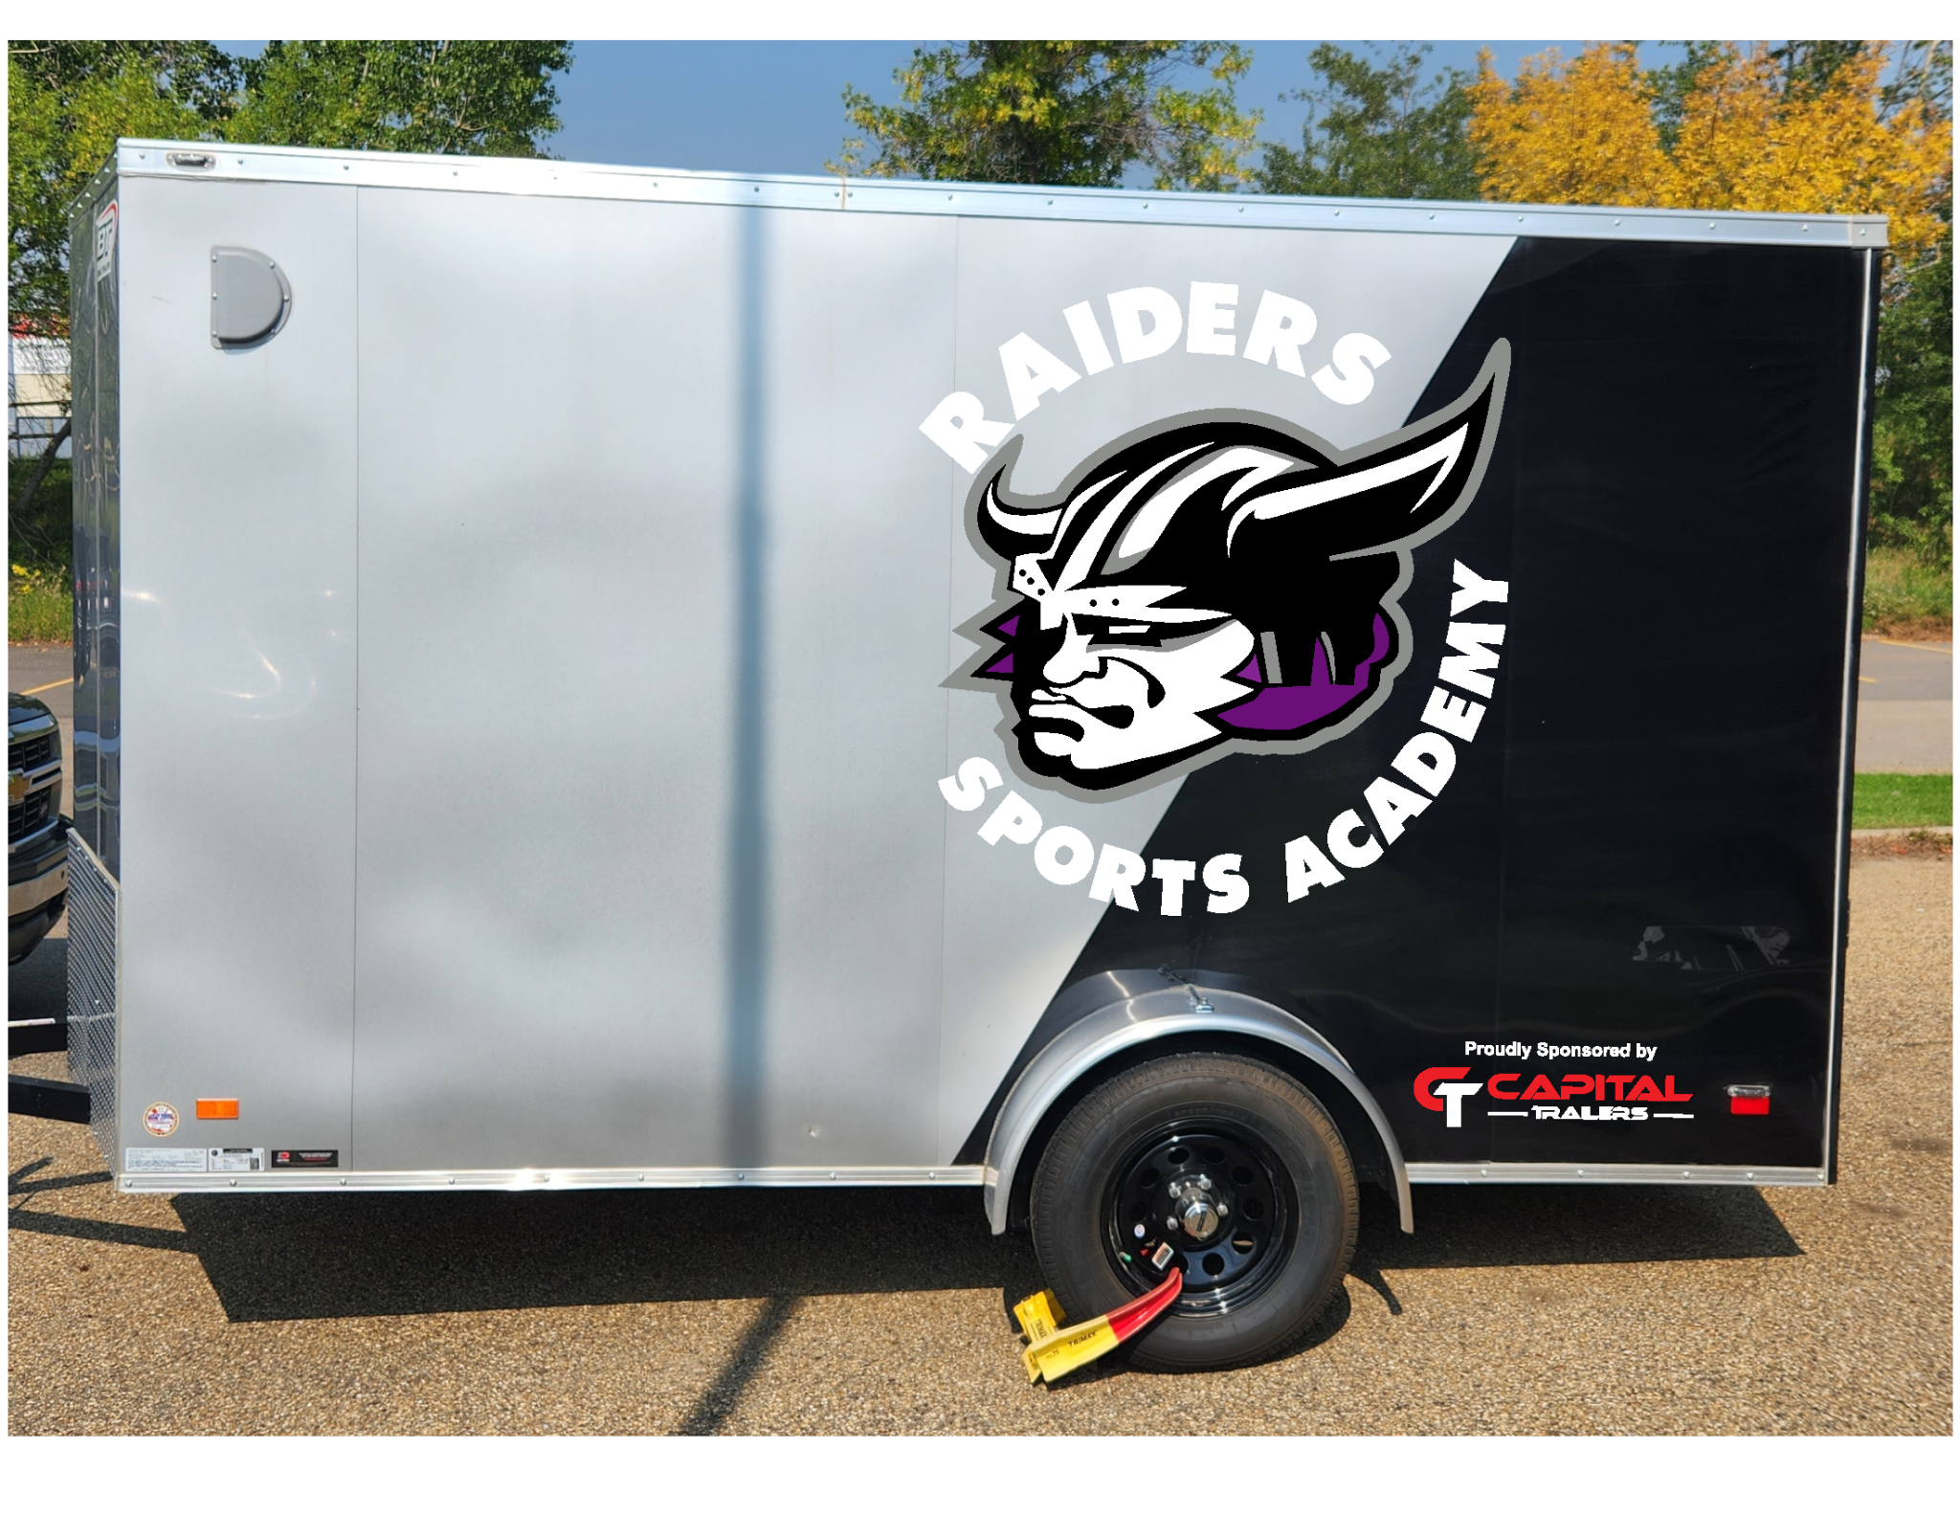

Slide 29
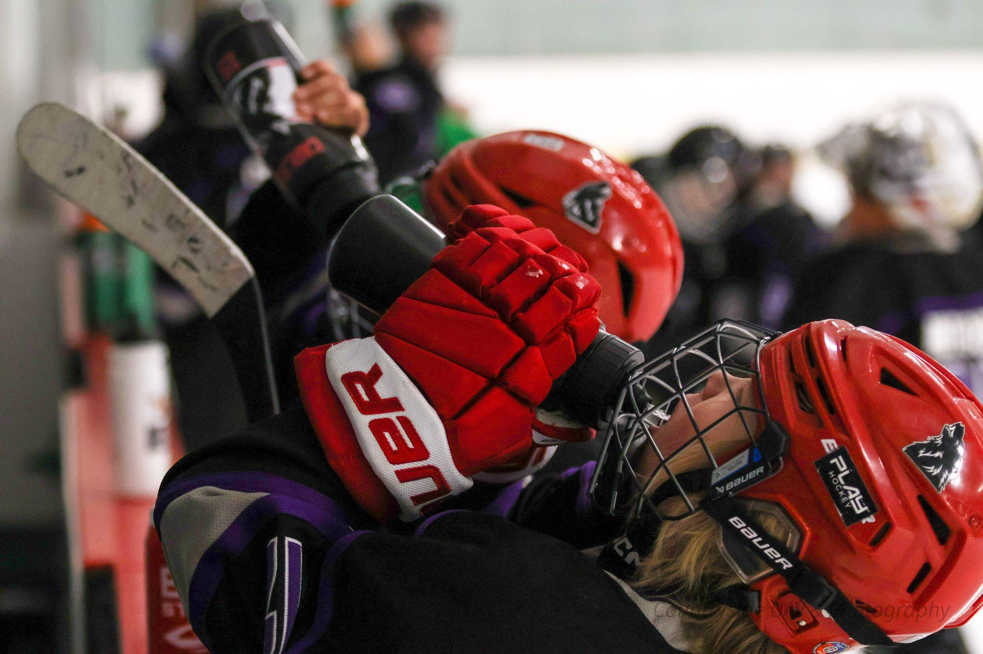
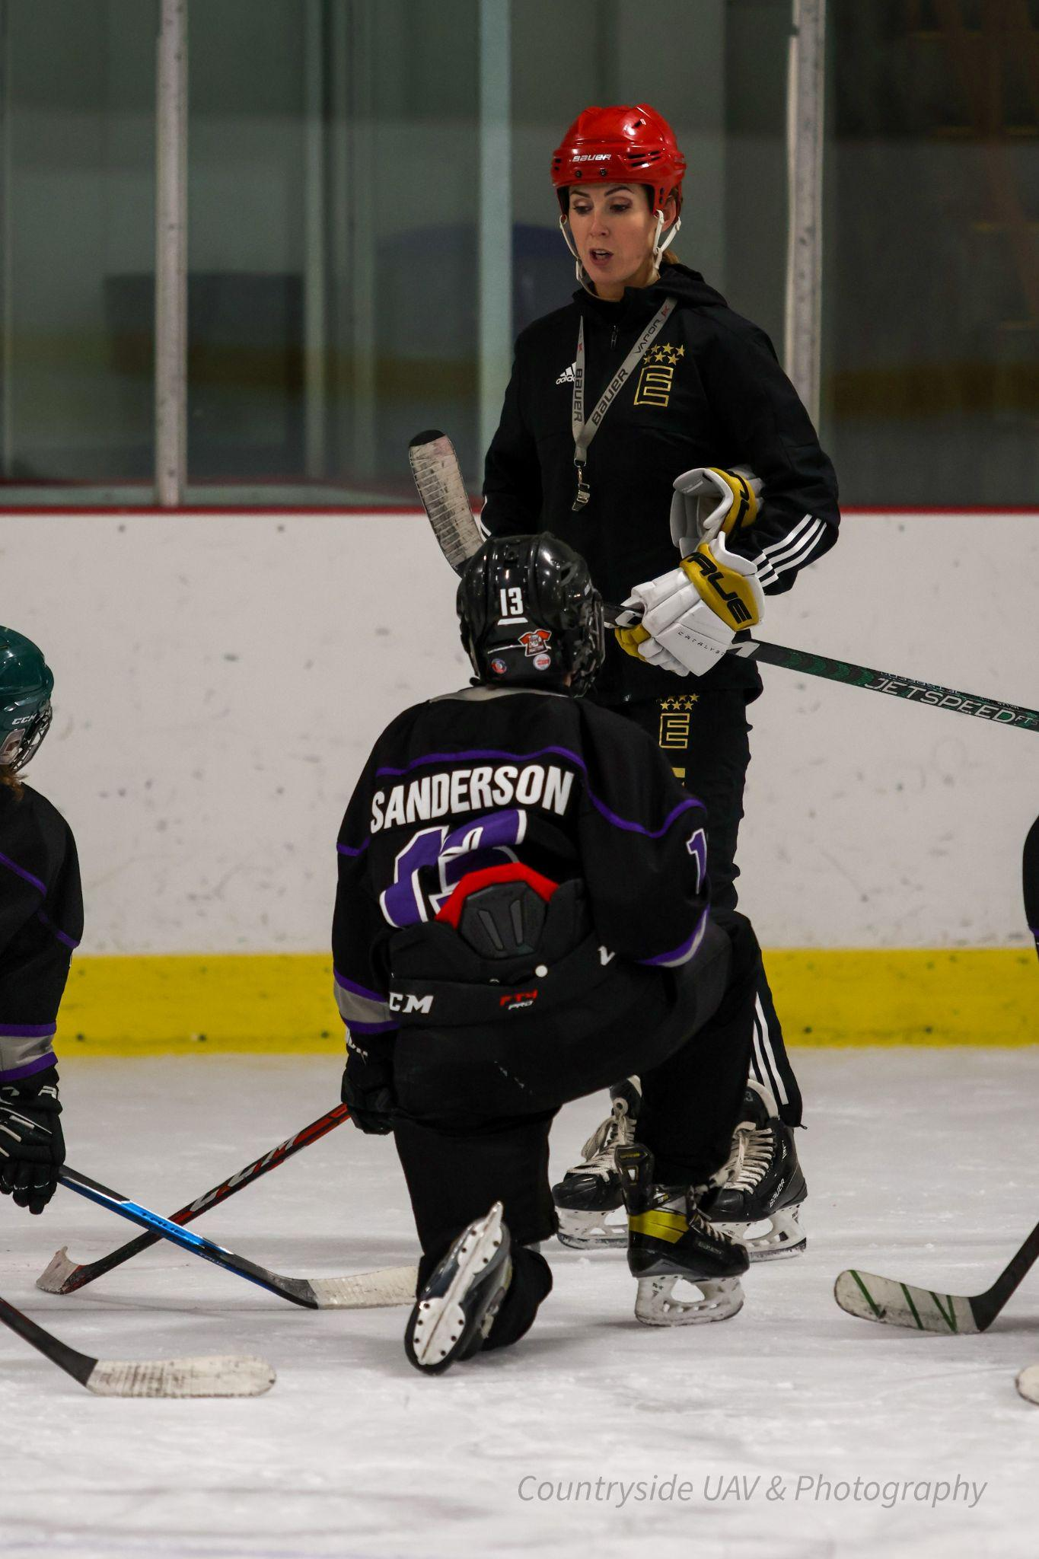
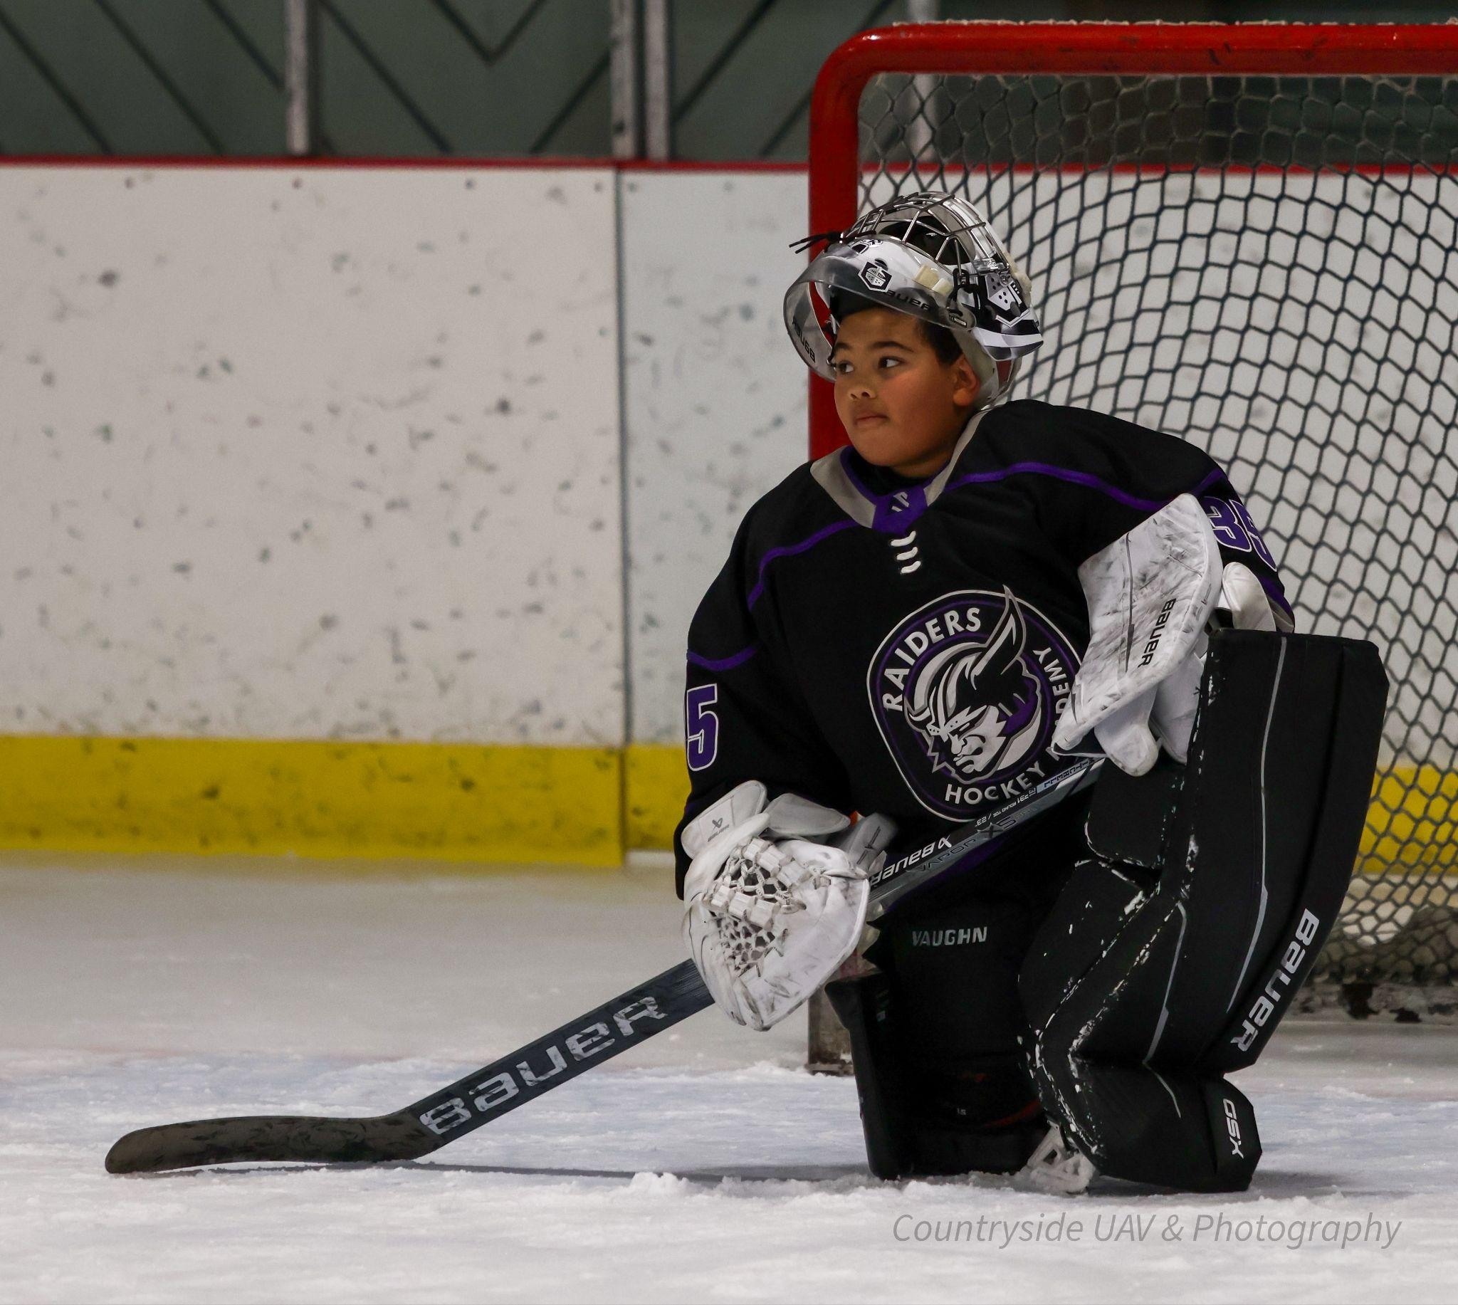
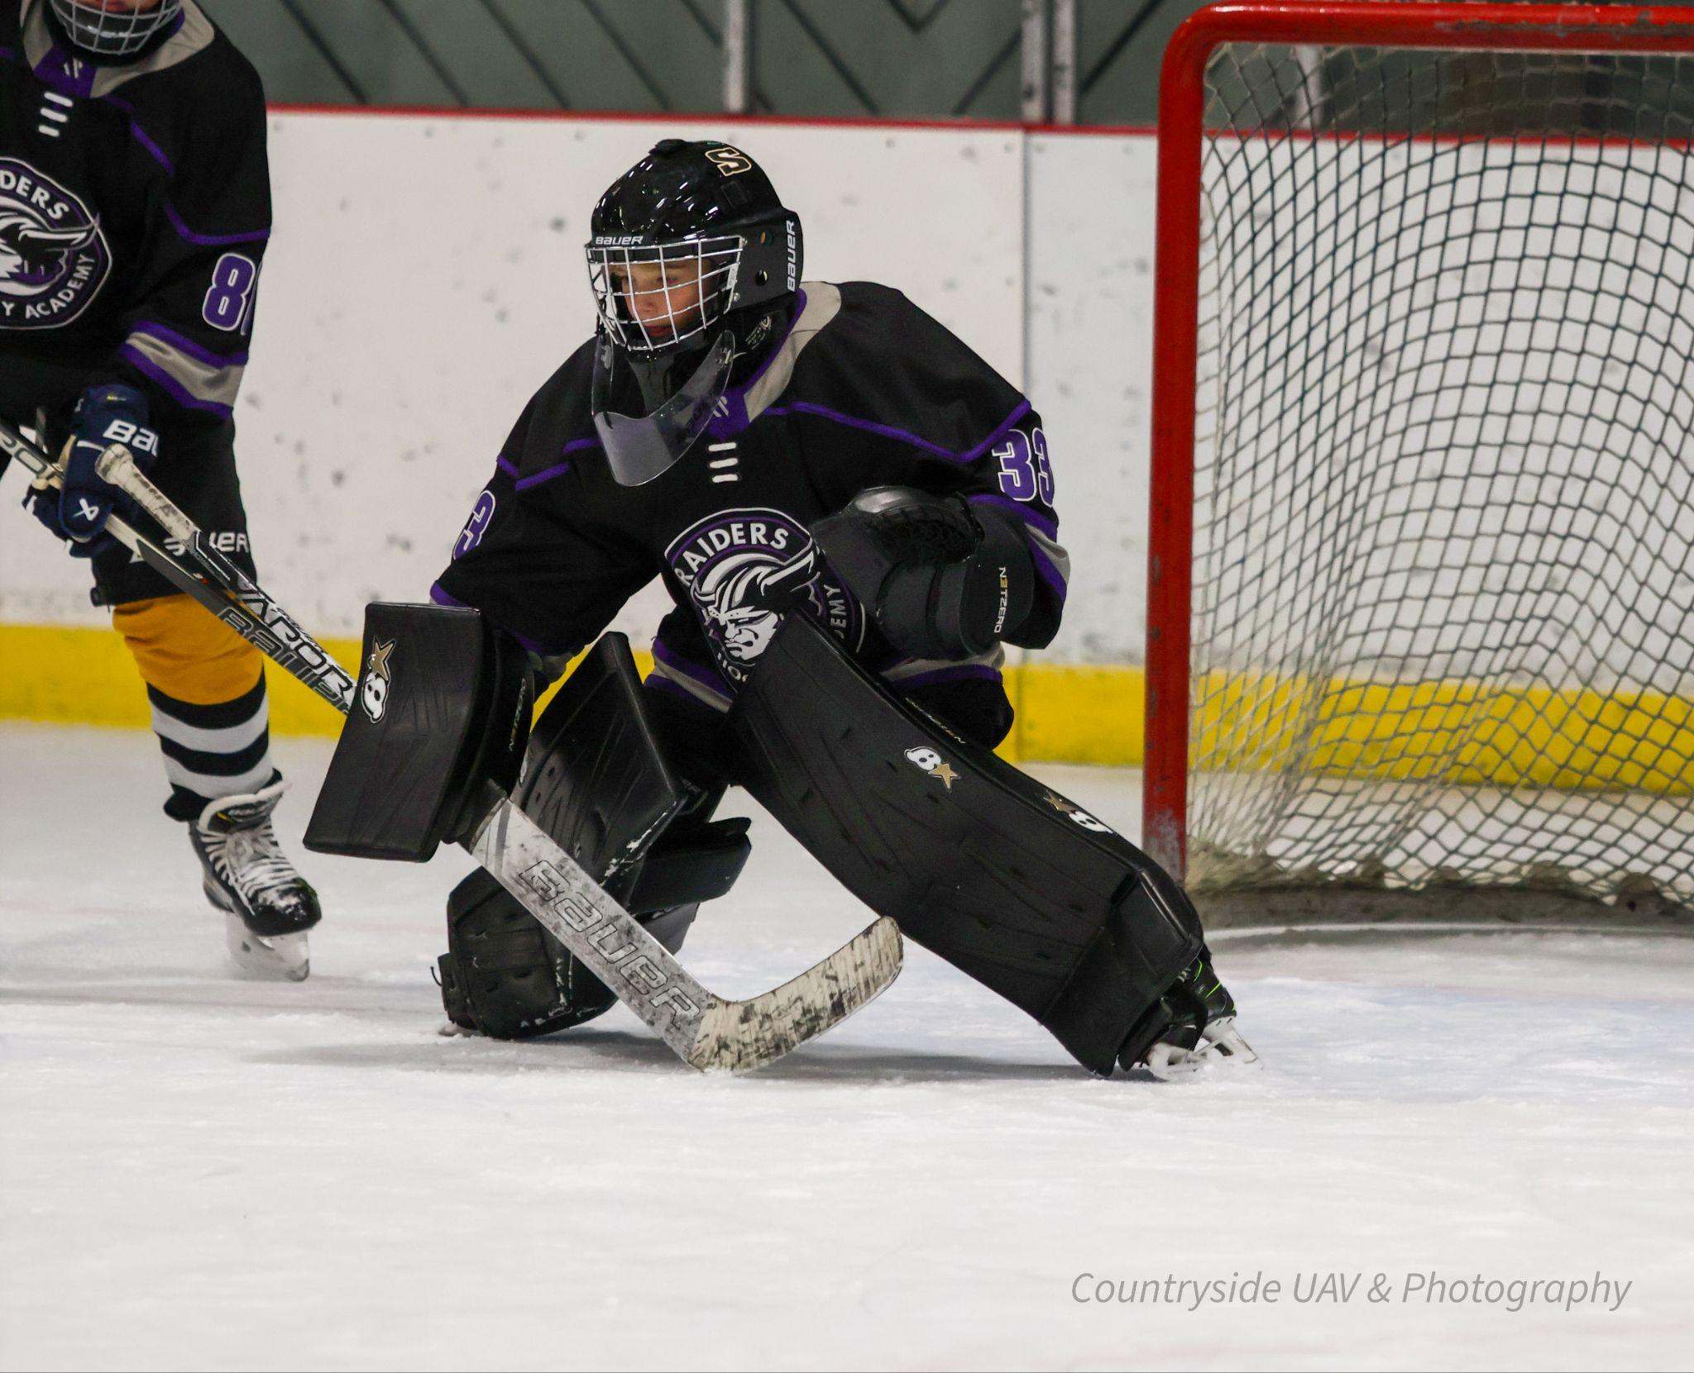
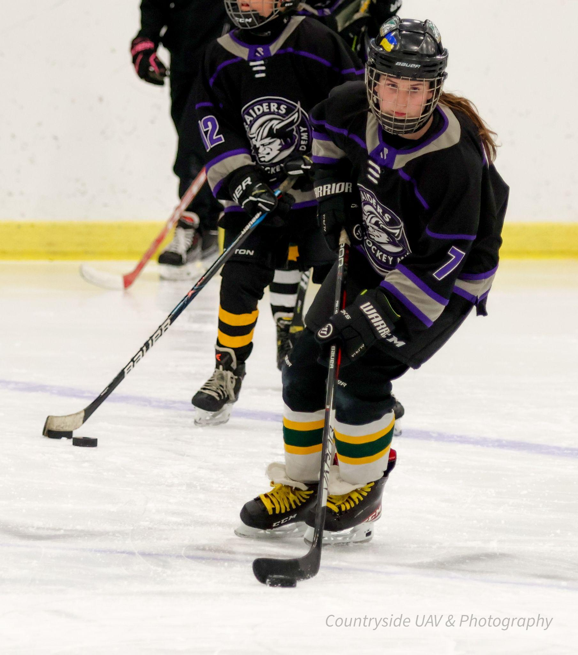
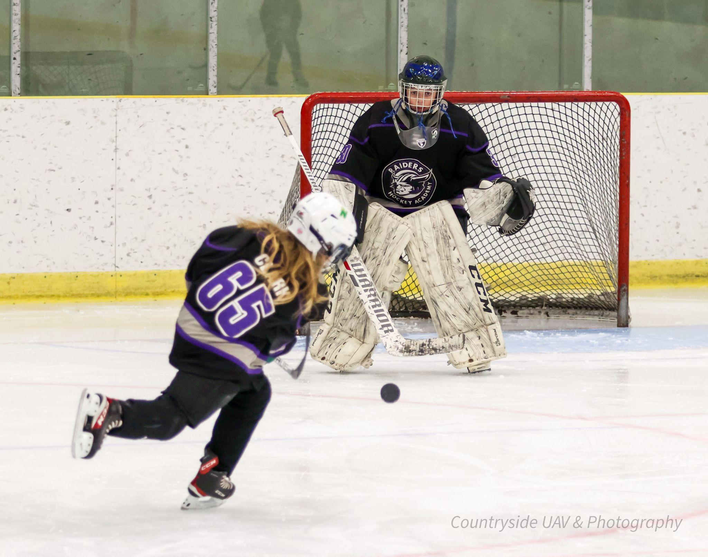
Photo Gallery - Posted Online

Slide 30
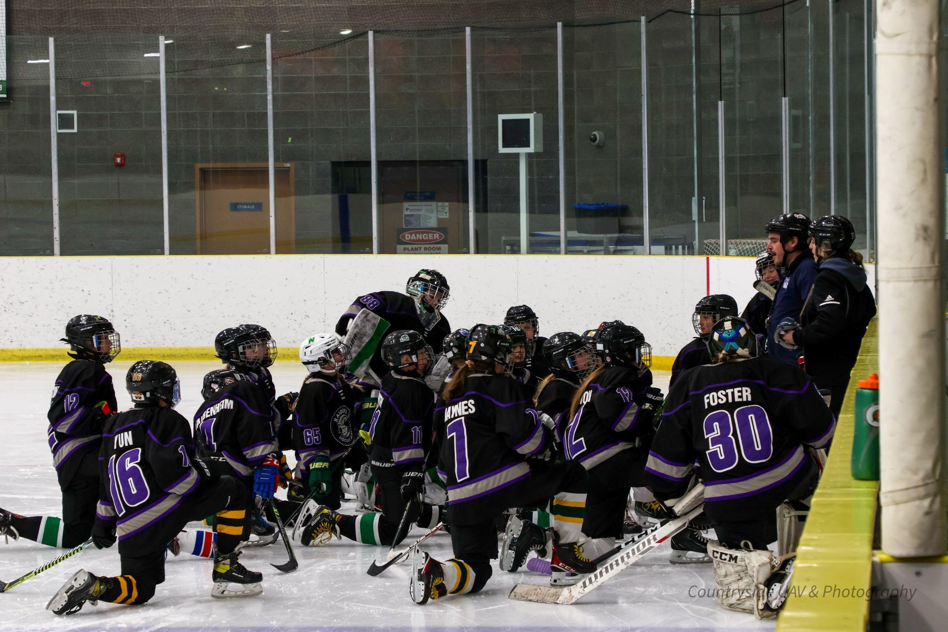
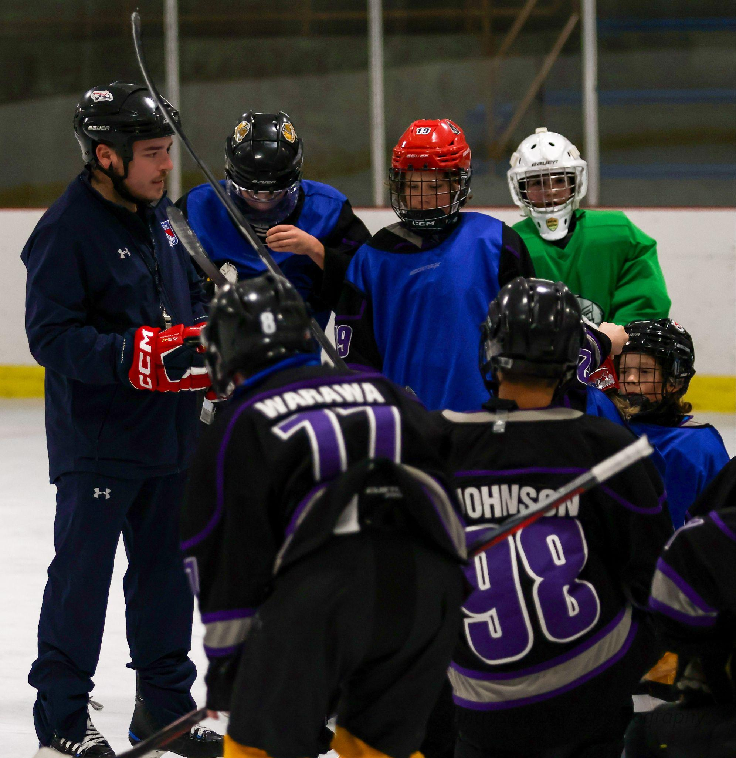

Slide 31
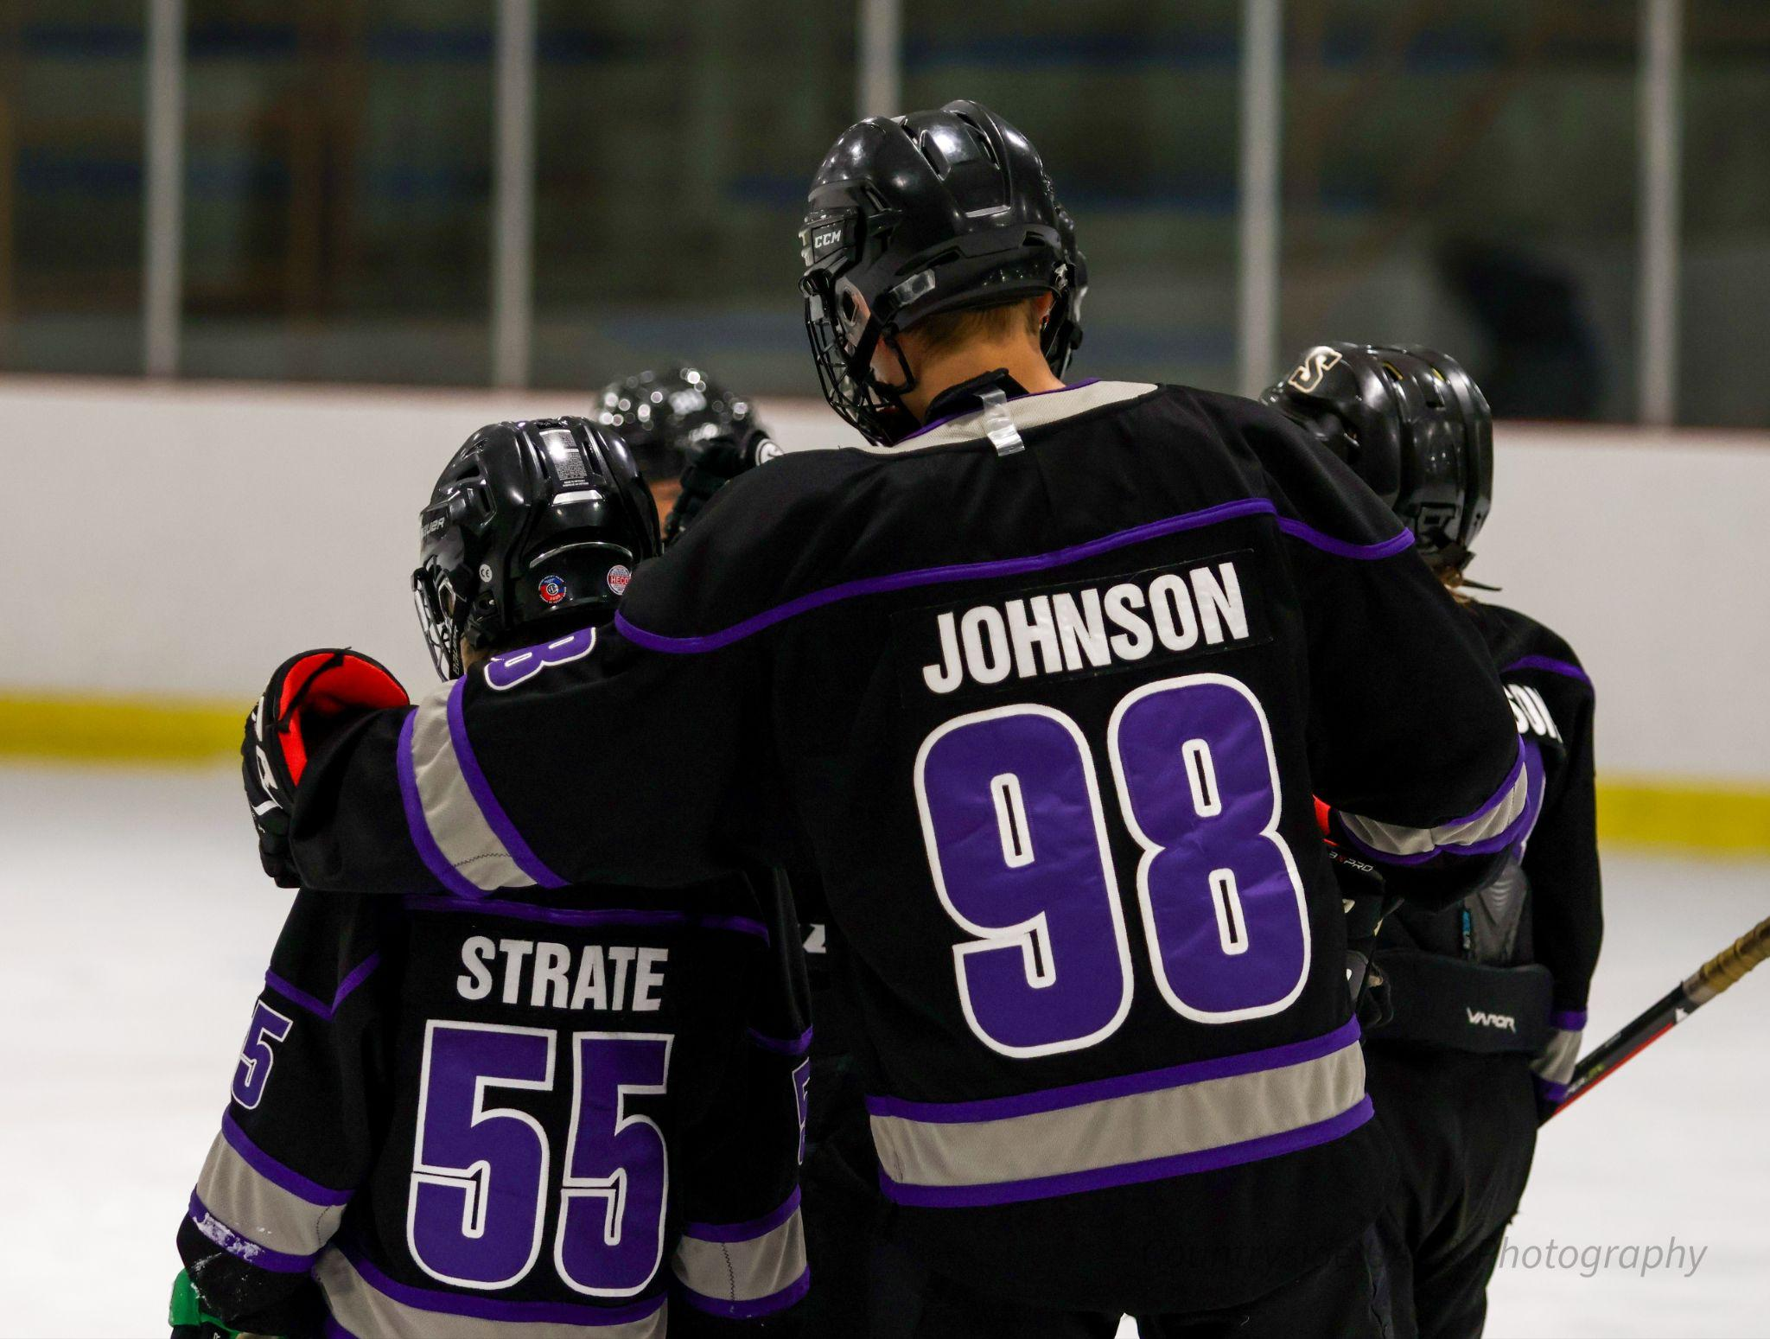

Slide 32
Transportation
Transportation to and from available from Sherwood Park - Location: Holy Spirit
Program Trips - into Glen Allen Rec. or Millenium Place in May/June for full year ice availability (included in fees)(based on academy interest)

Slide 33
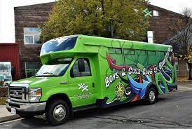
Boys and Girls Club - Before or After School
Available Before and After School at Holy Redeemer and Sherwood Park
Times available 6:30 a.m. - 8:30 a.m., After school until 6 p.m. or later if pre-arranged.
Boys and Girls Club Bus available to
Sherwood Park - Pick up at HR

Slide 34
School Boundaries (School of Choice Transportation Fees)
If you drive student(s) to/from school – No transportation fees
Holy Redeemer Boundary – Within 2 km (Gr. 7-8) or 1 km (Gr. 5-6) EICS - no transportation is required - ($360/year if required)
Outside 1 or 2 km, based on grade, there is a $180/year fee
Outside Holy Redeemer boundary but within EICS Boundary – $360/year
(Contact EICS –Transportation to see if there is an EICS boundary in your area)

Slide 35
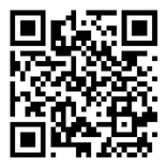
How To Register
Click on the QR Code found at the back of your brochure
EICS Students Step 1 - Complete this Google Form. Step 2 - Go to School Engage - Parent Portal and select our school for next year. Non-EICS Students
- Complete Google form and
- Go to the EICS website and register your child(ren) to Holy Redeemer - In the Language and Options box please write - Sports Academy Our Holy Redeemer office team will contact you to confirm your information and registration in the program.

Slide 36
Register today at www.eics.ab.ca
Thank you!
Questions and Answers…

